Slide 1

FreshGuard
Pitch Deck
Team BruteForce
Team Members:
Kushal Partani
Pranav Bhutada
Siddharth Chauhan
Yash Gupta
Feb 18, 2024

Slide 2
"Detect. Prevent. Nourish. Your food's guardian."

Slide 3

Our mission
Empowering Producers, Protecting Consumers:
Our gas sensor technology detects freshness and impurities, aiding producers in efficiently managing and selling perishable goods while ensuring consumer safety and satisfaction.

Slide 4
01
Problem

Slide 5




Problem
Yearly average global food loss and waste
Every year, a staggering 116 million tonnes of dairy products, along with over 31.5% of global fruit and vegetable production, go to waste.
45%
35%
of all fruit and vegetables
of all fish and seafood
30%
20%
of all cereals
of all dairy products
https://www.ifco.com/countries-with-the-least-and-most-food-waste/

Slide 6
02
Solution

Slide 7

Solution
Integration of gas sensors for real-time monitoring of food freshness.
Utilization of machine learning algorithms to analyze sensor data.
Threshold-based assessment for determining food edibility.
Empowering consumers and industries with proactive food management solutions.

Slide 8





Solution
Gas Sensors Reading
Model Prediction
Server (Local)
Server(FireBase)
FreshGuard App
Step 1
Step 2
Step 3

Slide 9
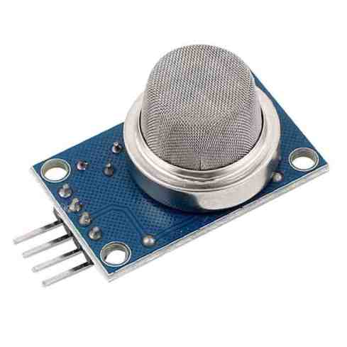
Solution
Network of 7 to 11 gas sensors strategically positioned
Sensors continuously monitor the environment surrounding the food
Gases include CO, CH4, H2, VOC and others
Robust regressor-based model using Neural Network architecture
User-friendly mobile application
This app allowes users to access detailed insights into food quality.
MQ-2 Gas sensor (for reference)

Slide 10
03
Product

Slide 11
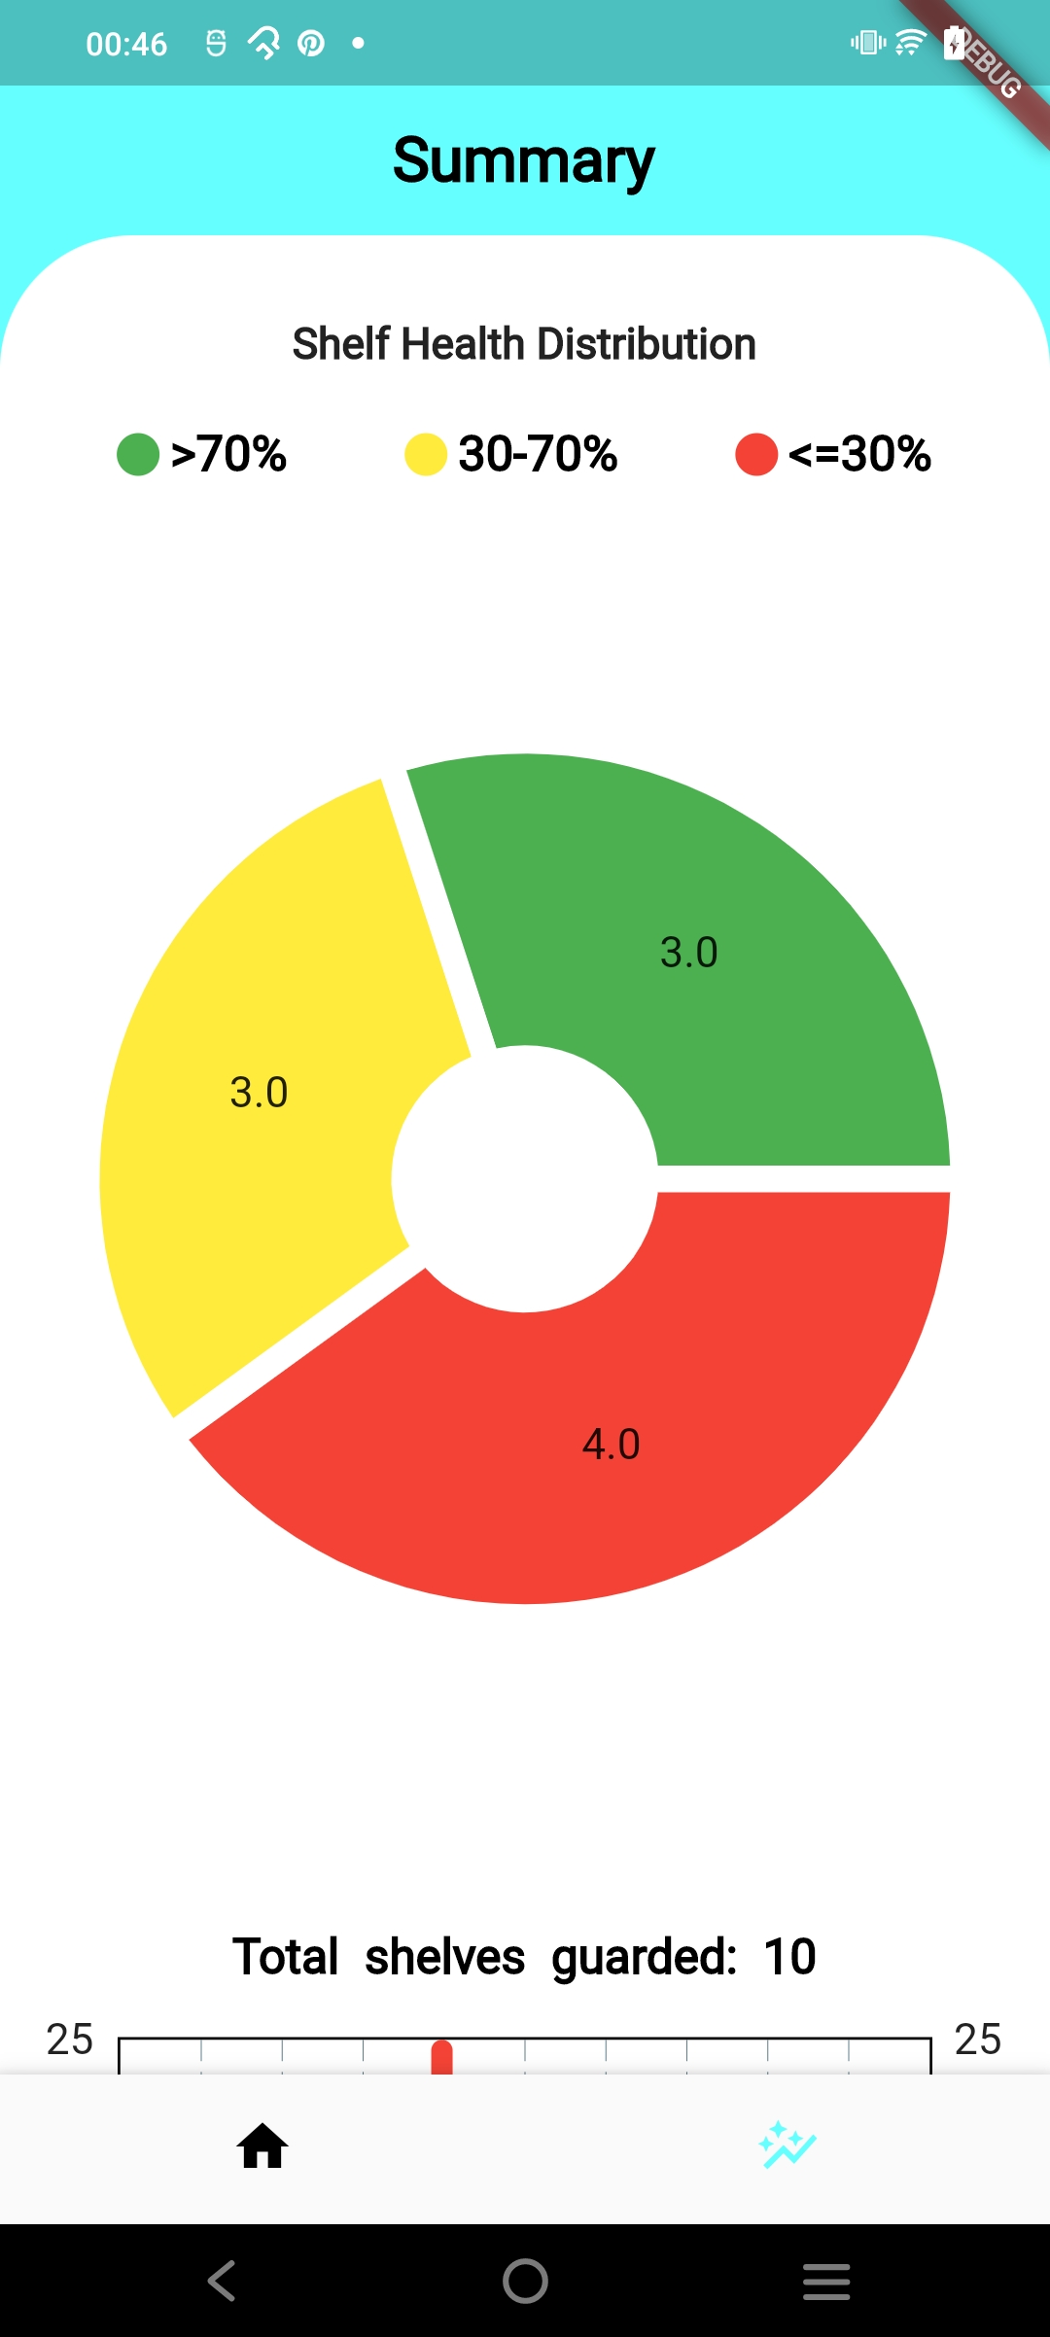
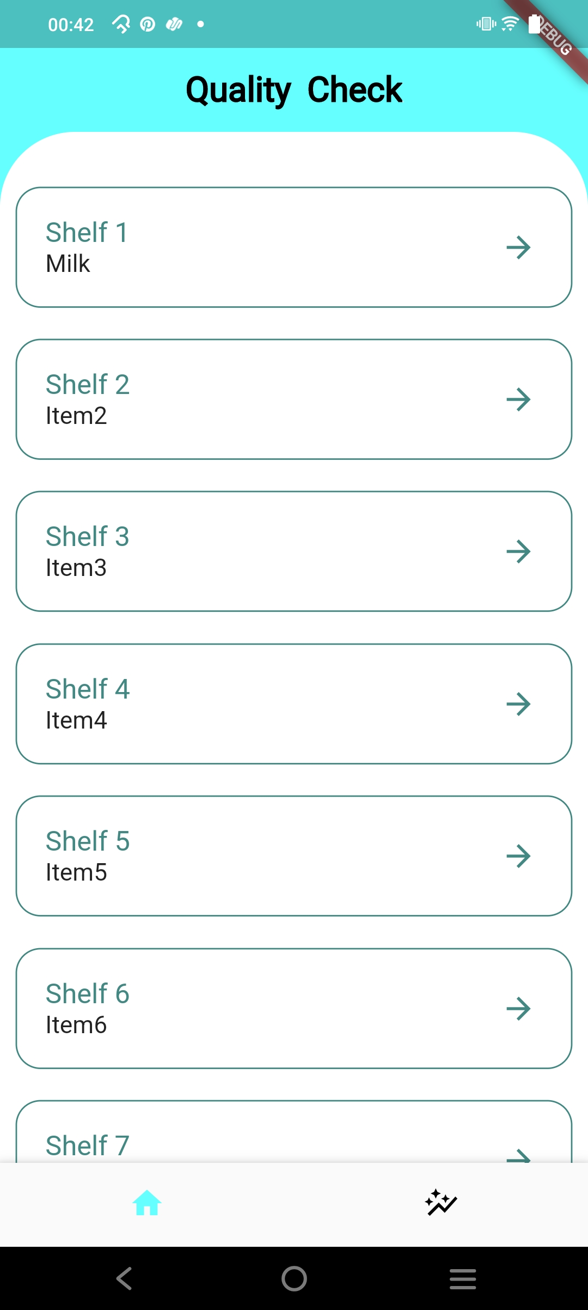
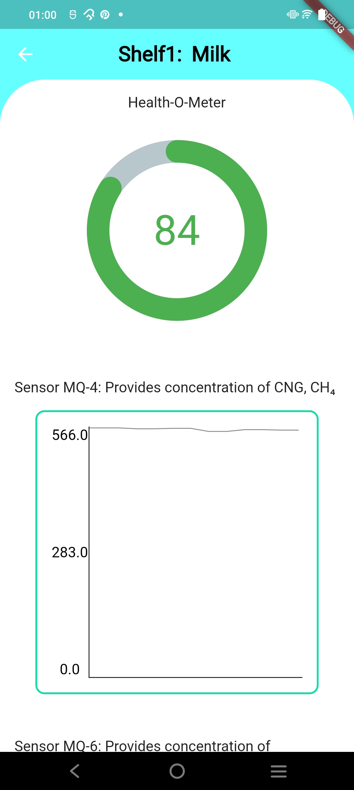

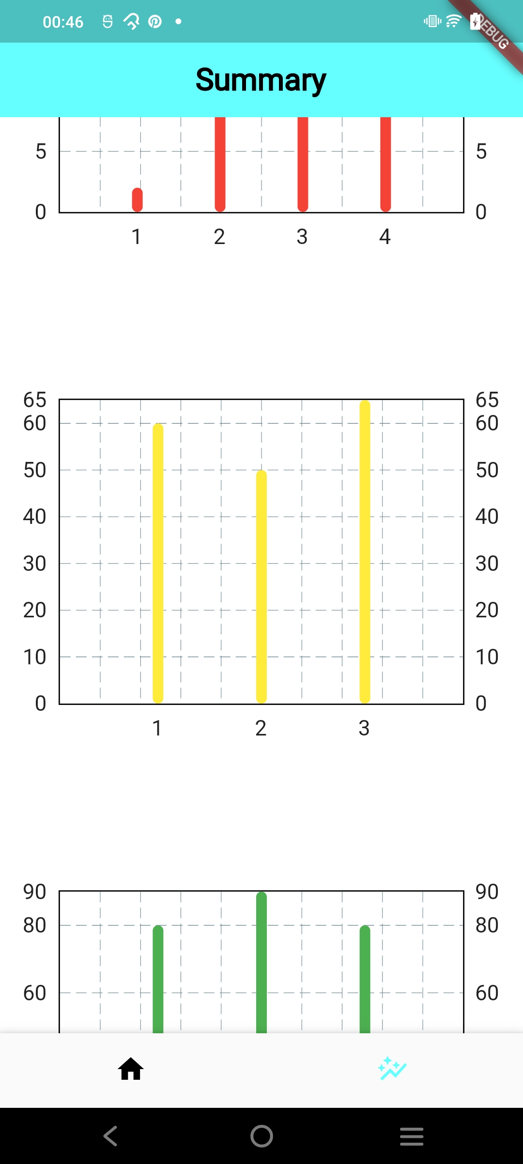
Product
List all storage units
Summary for brief overview
Detailed sensor statistics/graphs for each storage unit
A simple dashboard for keeping track of
all your storage units at a single stop.
Real time statistical analysis over
all storage units for detection and location of anomalies
For completeness, we provide complete
transparency of our sensors to let users
get a feel of Real-Time experience

Slide 12
Product
Precise Monitoring
Real Time Alerts
Remote Monitoring
Cost Effective solution
Scalability

Slide 13
04
Business Model

Slide 14
Product
Unique Selling Proposition
We offer a unique selling proposition (USP) by employing regression analysis to provide a nuanced quality score ranging from 0 to 100 across various products.
Our models are easy to develop over a wide range of products and scalable as well.

Slide 15
Indian Cold Storage Market Logistics
Potential Market:
Global Food Industry: The approximate food industry is $8 trillion.
Accessibility to SMEs and Emerging Markets: Our cost-effective solution makes spoilage detection technology accessible to small and medium-sized enterprises (SMEs).
Billion (USD)
Source: https://www.mordorintelligence.com/industry-reports/india-cold-chain-logistics-market

Slide 16
Business model
One Time Cost
INR 2000
Hardware Setup Cost
1 year free subscription on FreshGuard
Subscription Cost (Per Month)
INR 69/- per month
Data Analytics
Real Time monitoring
Subscription Cost (Per Year)
INR 600/- (INR 49 per month/-)
Data Analytics
Real Time monitoring

Slide 17
05
Competitors

Slide 18

Competitors
Relies on IoT devices and radiation sensors for food spoilage detection.
Approximately INR 25,000 , making it a significant investment for businesses.

Slide 19
06
Evidence

Slide 20
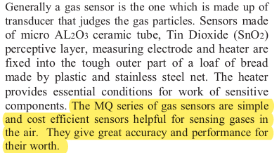
Evidence
References
https://ieeexplore.ieee.org/document/10212608
https://ieeexplore.ieee.org/document/8453375
https://ieeexplore.ieee.org/document/9426263
https://ieeexplore.ieee.org/document/8710944

Slide 21
DEMO
Google Drive Link:
https://drive.google.com/file/d/1MD5abmM8bD8N8W7BY5DzgUcsCuES6i6n/view?usp=sharing

